Slide 1
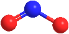
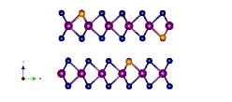
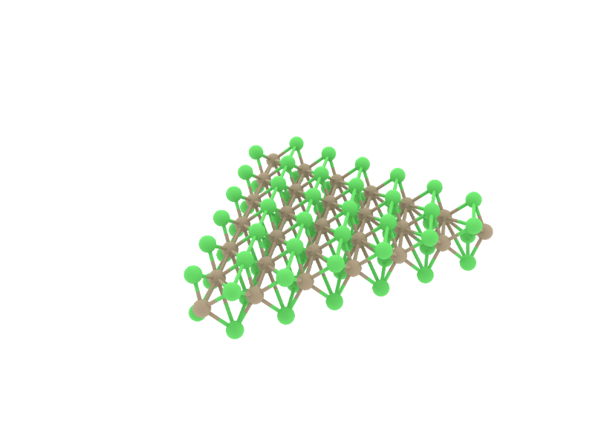
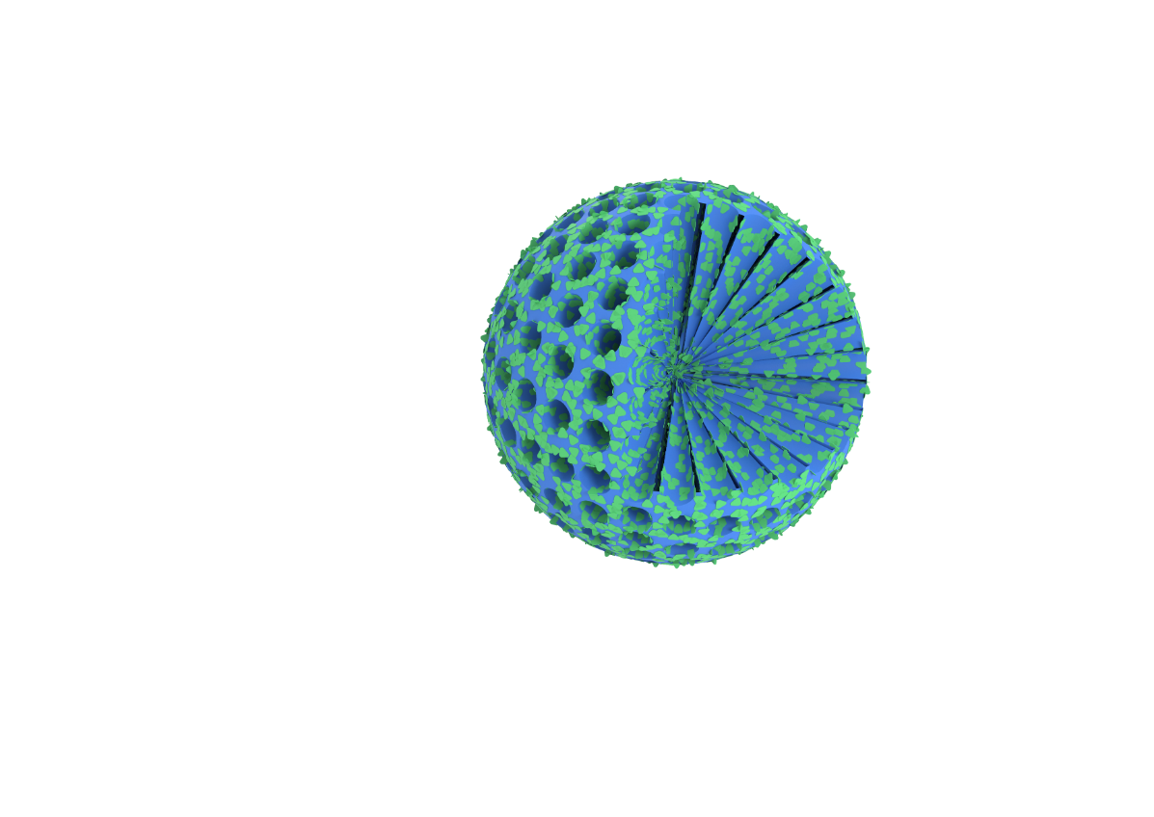
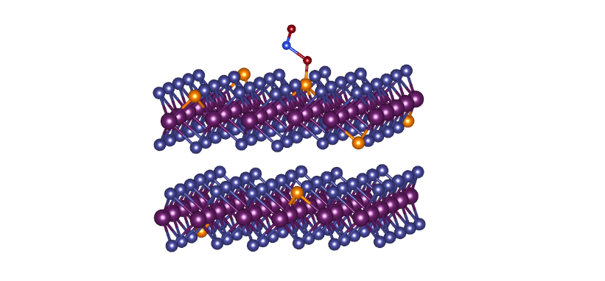
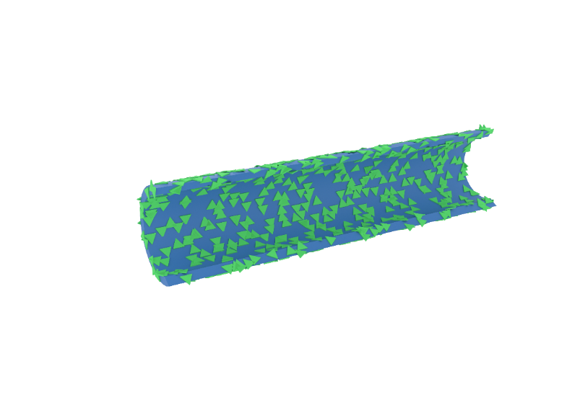
Exposed edge-sites
High carrier mobility
e⁻
e⁻
Pore
e⁻
Knudsen diffusion
Radial pore channel
In-situ Heteroatom-doping

Slide 2
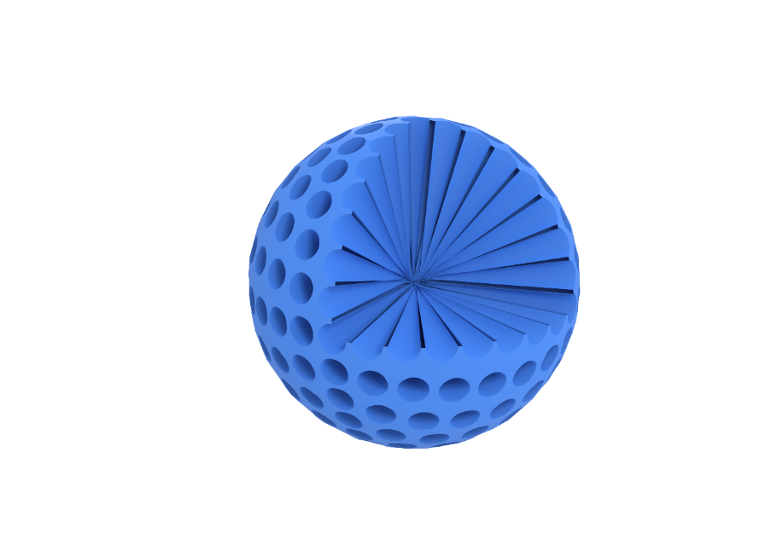
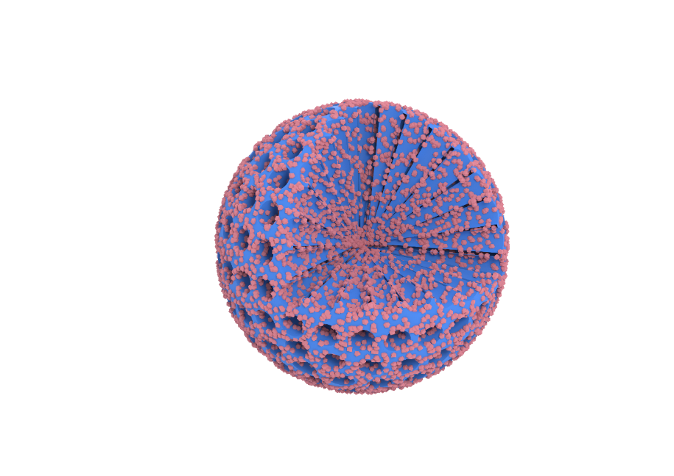
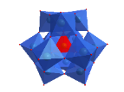
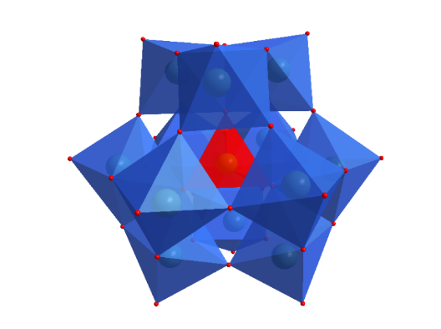
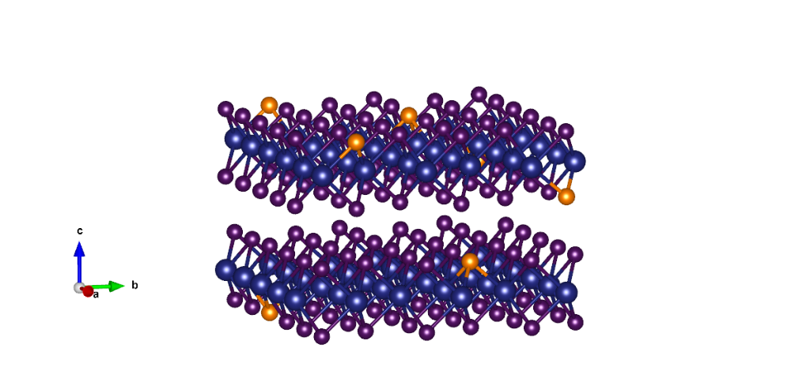
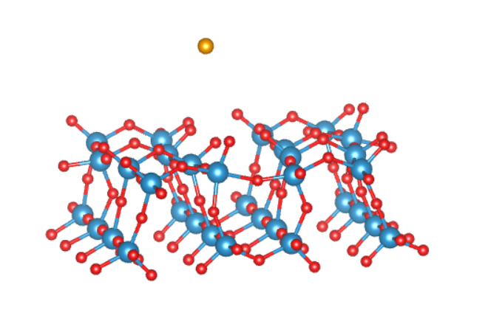
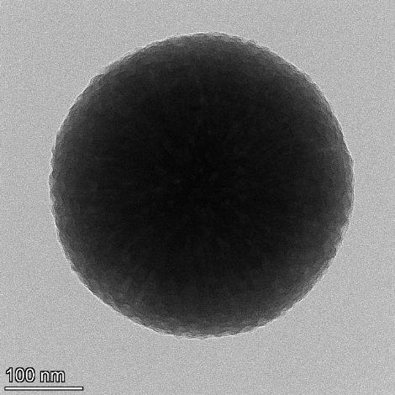
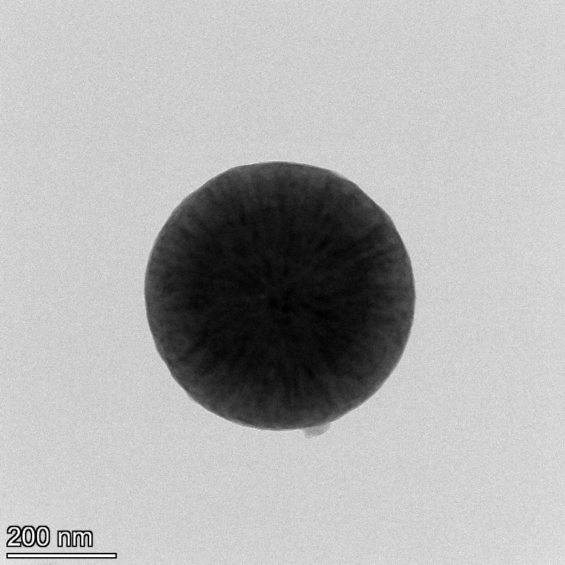
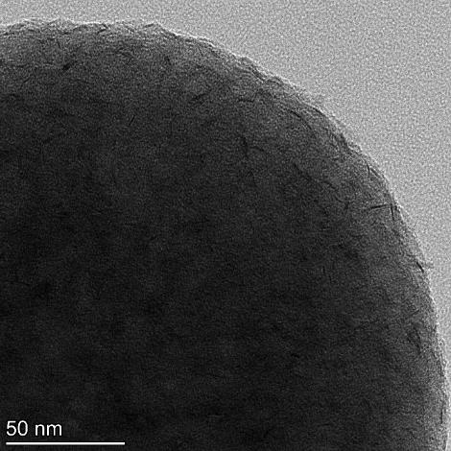
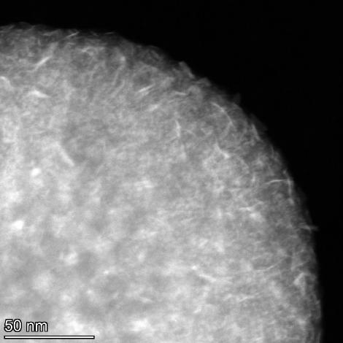
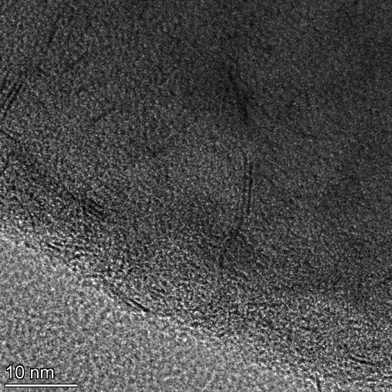
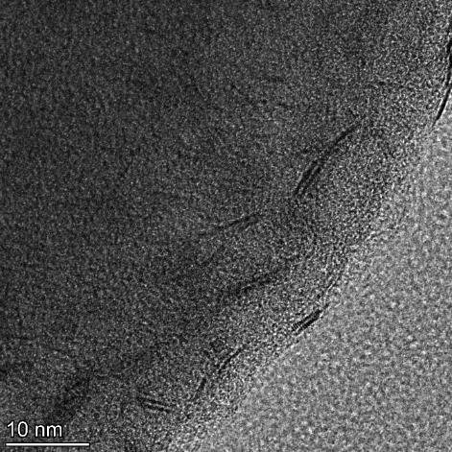
(a)
Se
adsorption
TAC
mPDA
mPDA@POMs
mN-C@P-WSe₂
pyrolysis
selenization
H₃PW₁₂O₄₀
P-doped WO₃
P-doped WSe₂
(b)
(c)
(d)
(e)
100 nm
100 nm
200 nm
100 nm
(f)
(g)
(h)
Internal WSe₂ of the channels
(i)
Mesoporous
0.65 nm
WSe₂ (002)
0.237 nm
WSe₂ (103)
50 nm
50 nm
10 nm
10 nm
(j)
(k)
(l)
C
N
O
50 nm
100 nm
P
W
Se

Slide 3
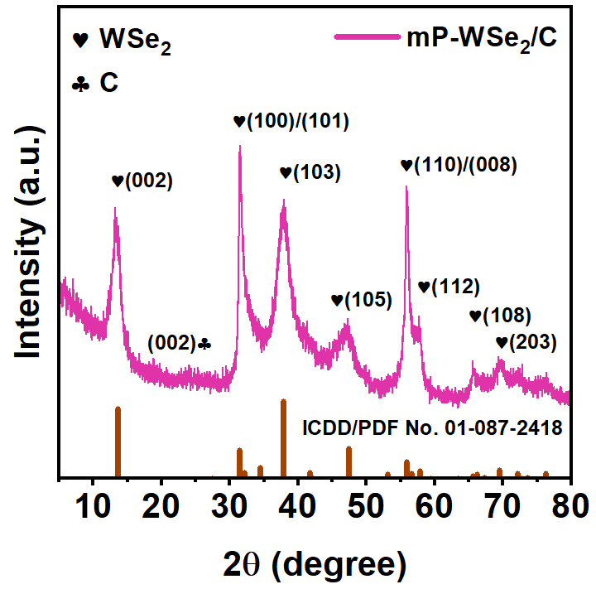
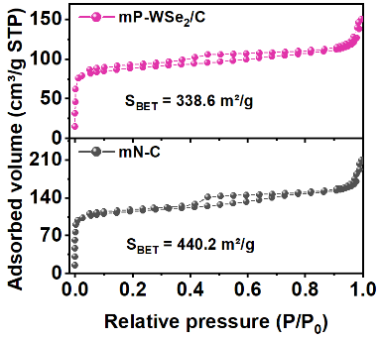
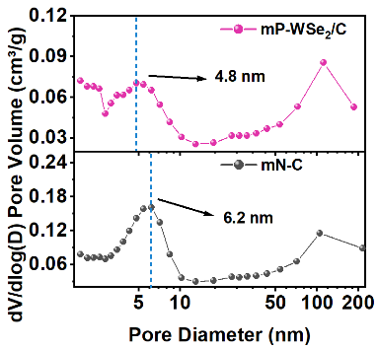
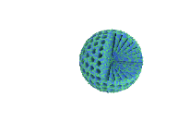

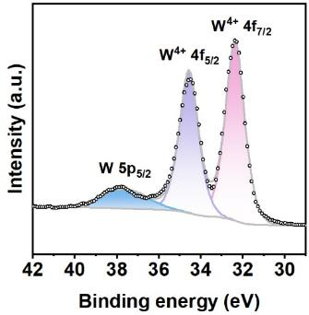
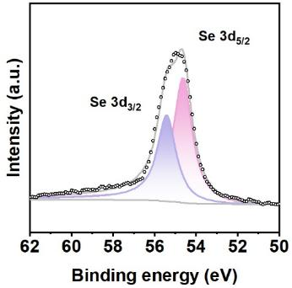
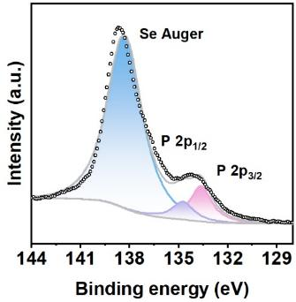
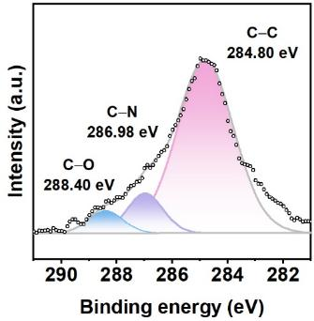
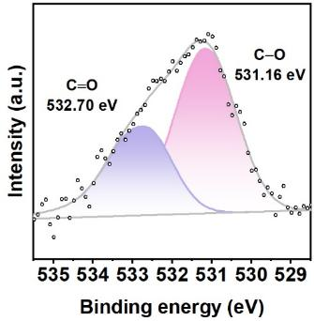
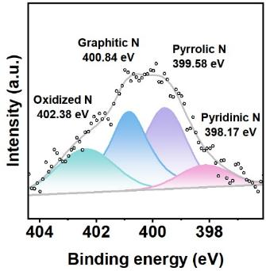
(a)
(b)
(c)
(d)
(e)
(f)
W 4f
Se 3d
P 2p
(g)
(h)
(i)
C 1s
O 1s
N 1s

Slide 4
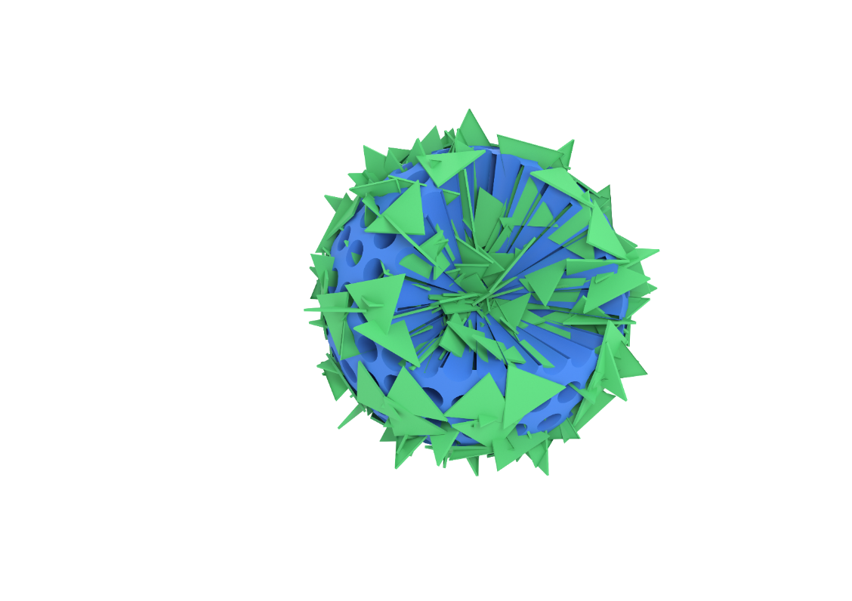

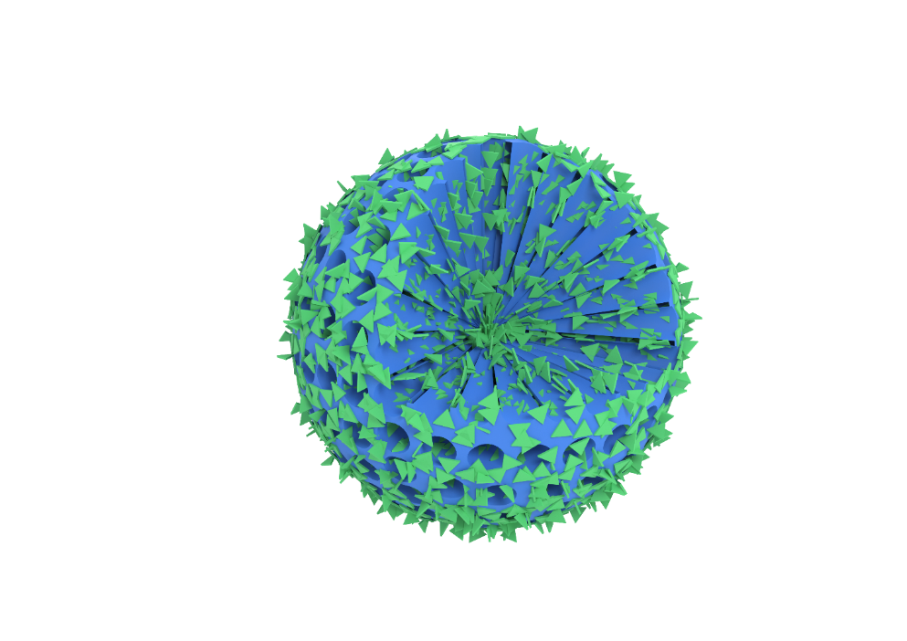
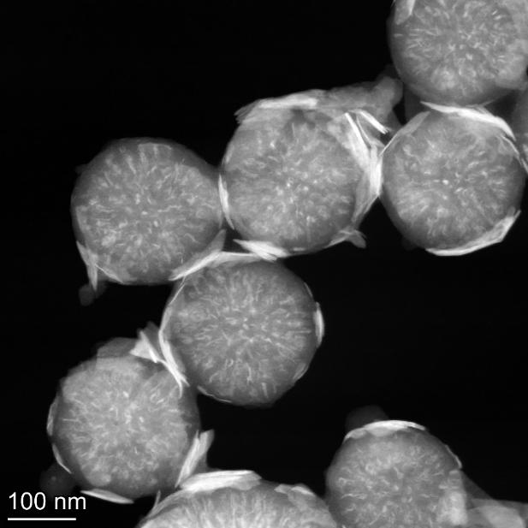
Pores
blocking
500 ºC
600 ºC
700 ºC
(a)
(b)
(c)
(d)
100 nm
100 nm
100 nm
(e)
(f)
(g)
200 nm
200 nm
100 nm

Slide 5
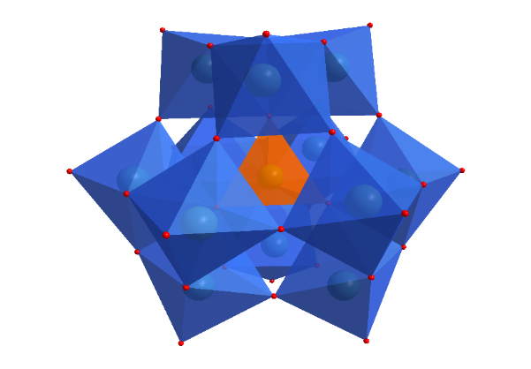
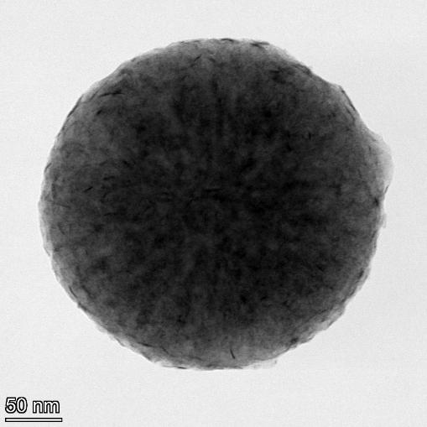
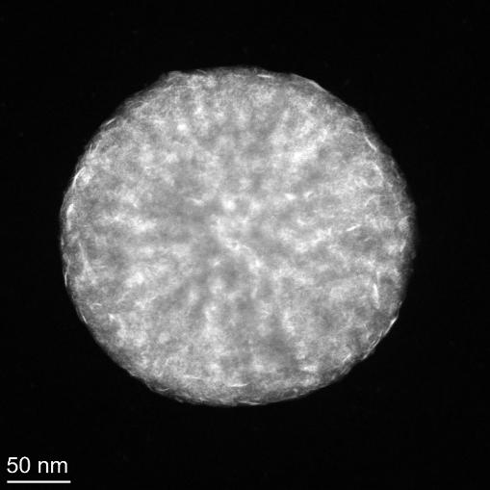
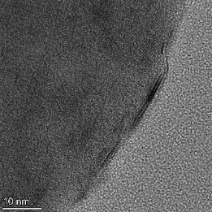
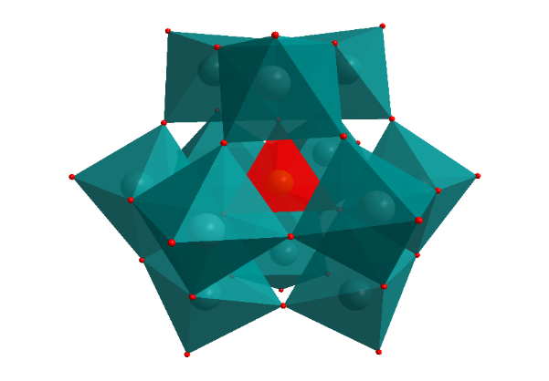
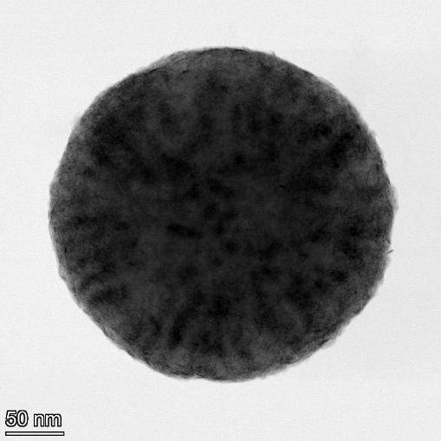
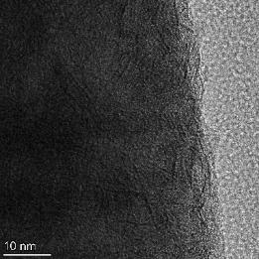
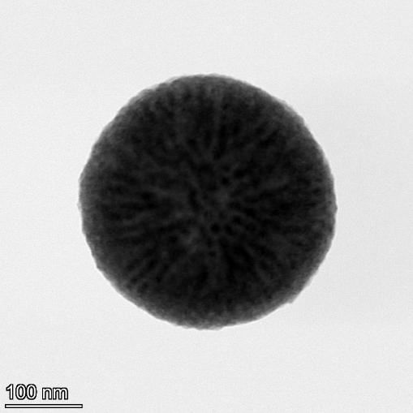
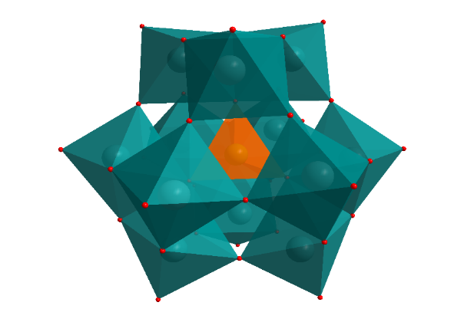
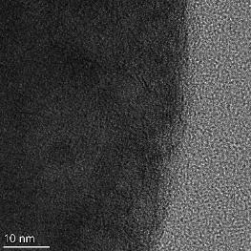
(a)
Si-WSe₂
(b)
(c)
(d)
C
N
O
H₃SiW₁₂O₄₀
50 nm
50 nm
50 nm
0.65 nm
WSe₂ (002)
Si
W
Se
(e)
P-MoSe₂
(f)
(g)
(h)
C
N
O
H₄SiMo₁₂O₄₀
50 nm
50 nm
50 nm
0.64 nm
MoSe₂ (002)
P
Mo
Se
(i)
Si-MoSe₂
(j)
(k)
(l)
C
N
O
50 nm
100 nm
100 nm
0.64 nm
MoSe₂ (002)
H₃PMo₁₂O₄₀
Si
Mo
Se

Slide 6
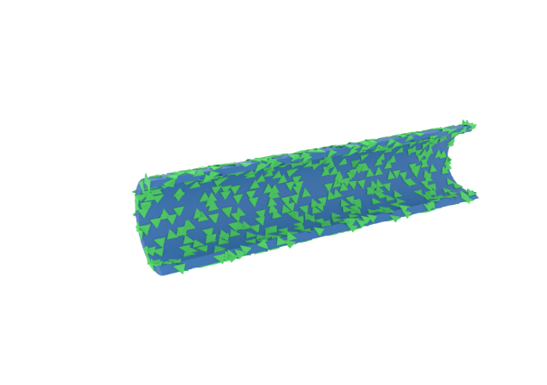
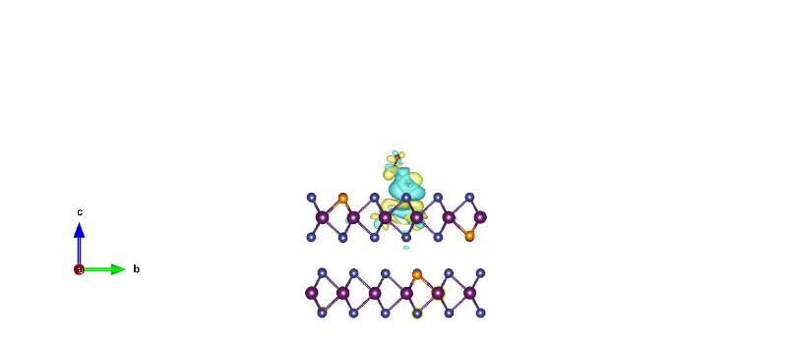
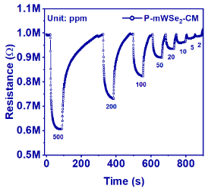
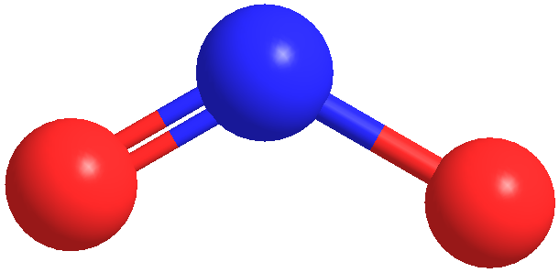
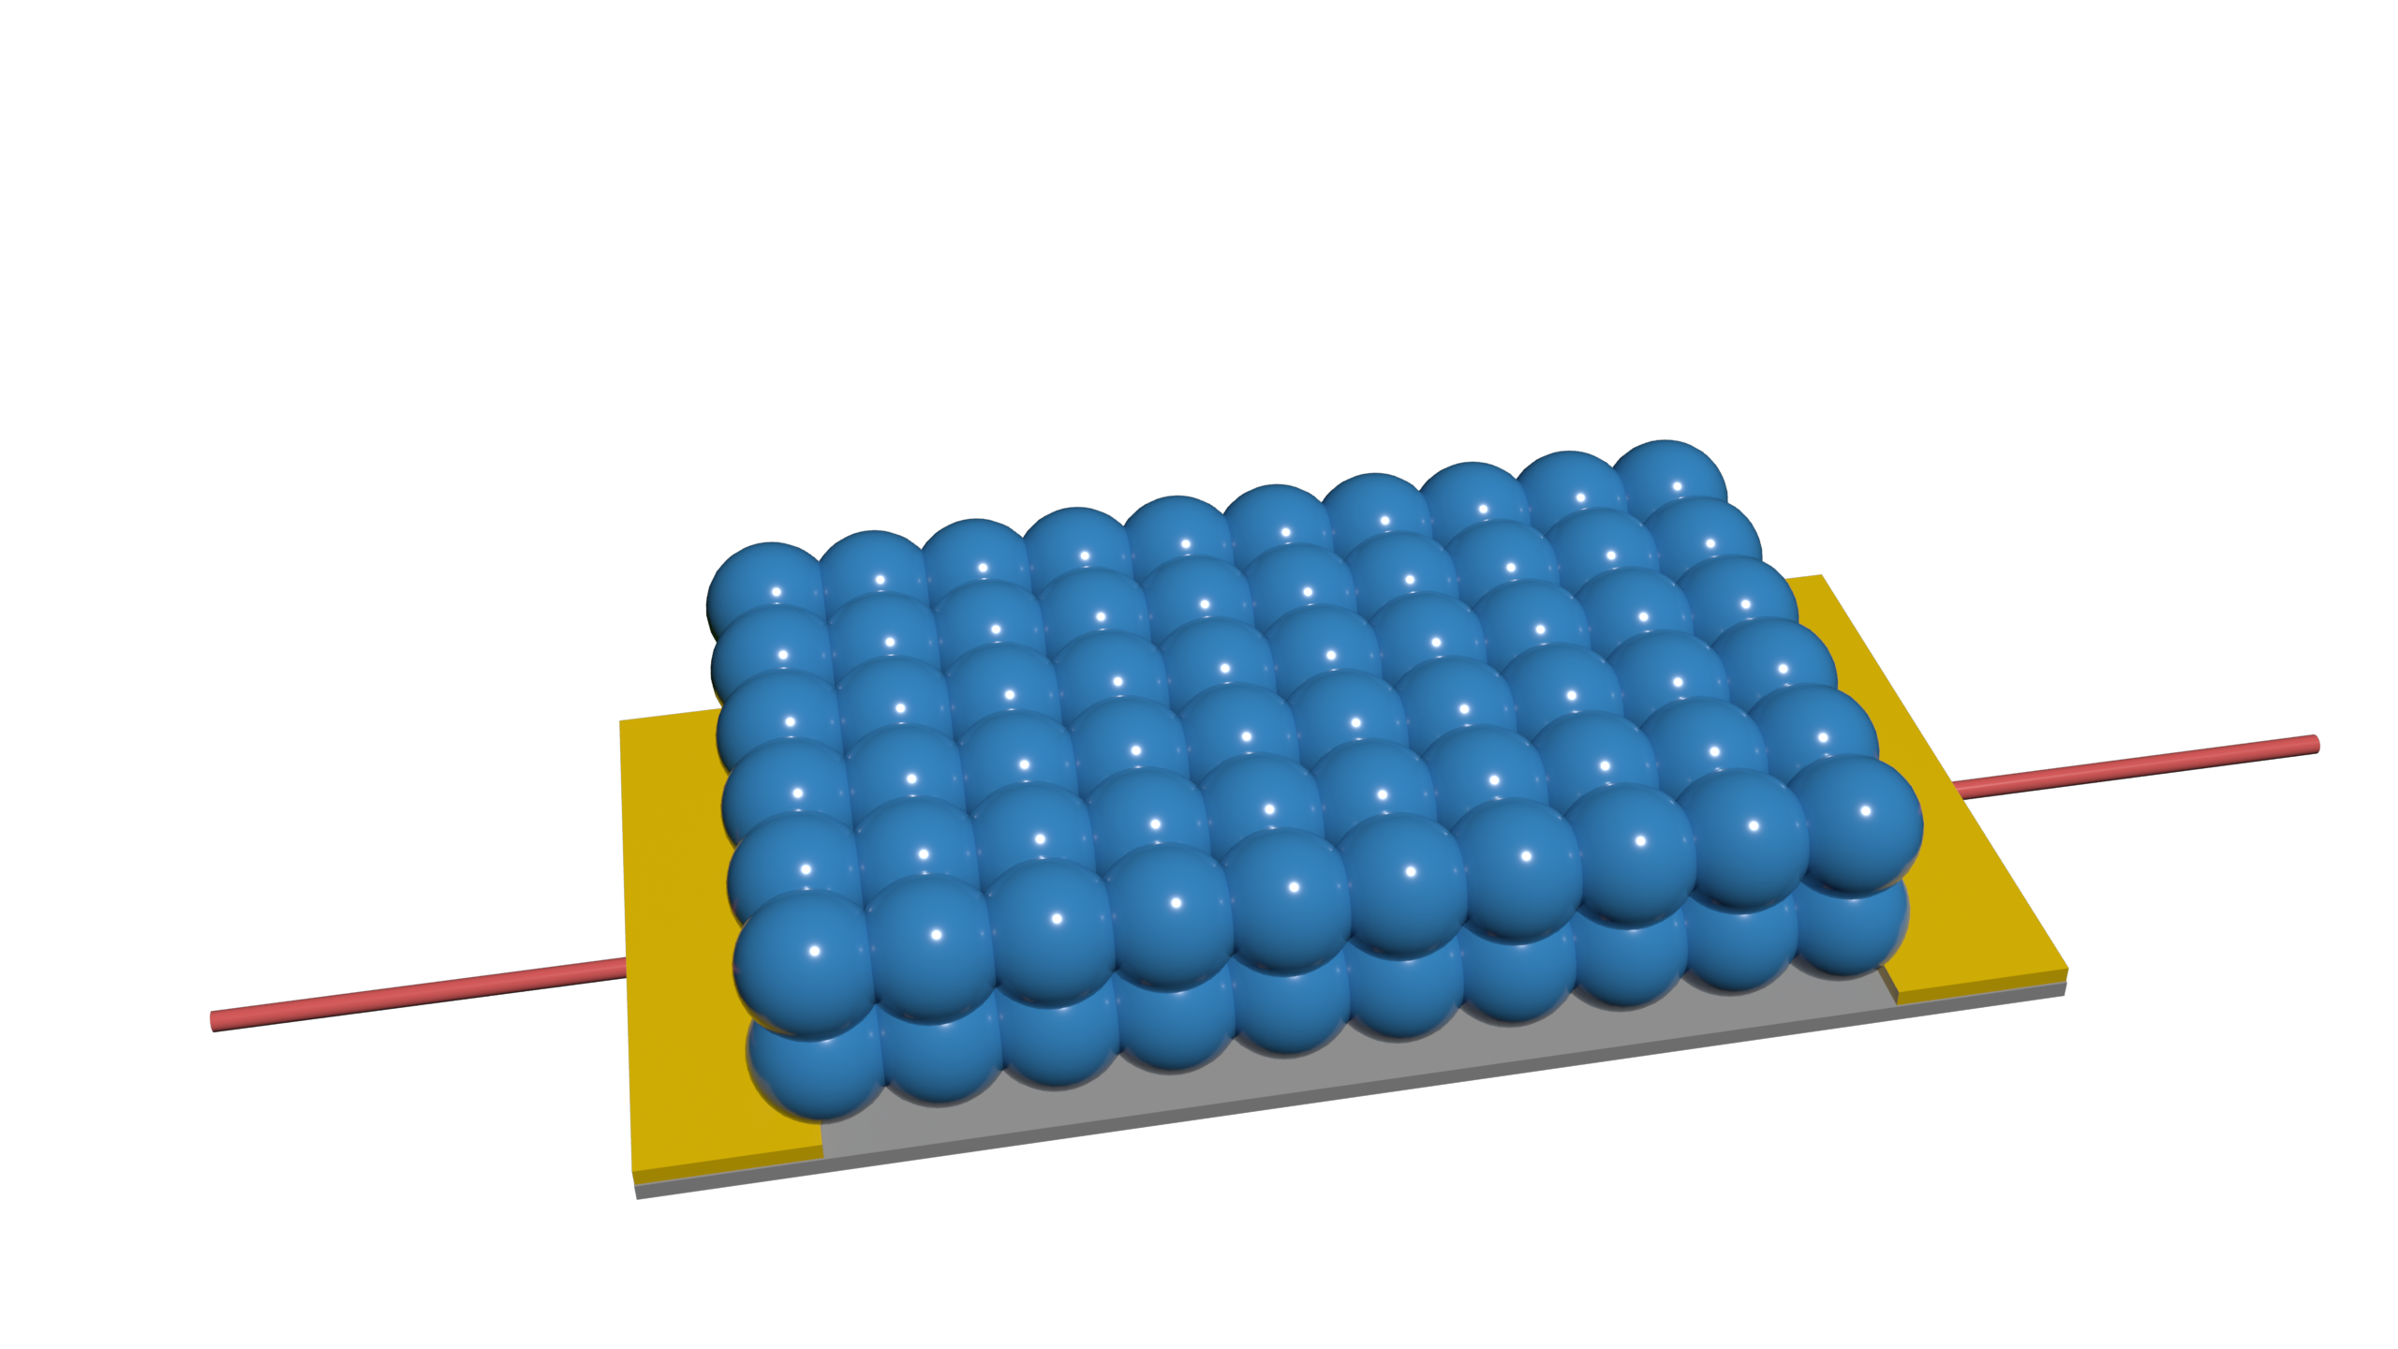

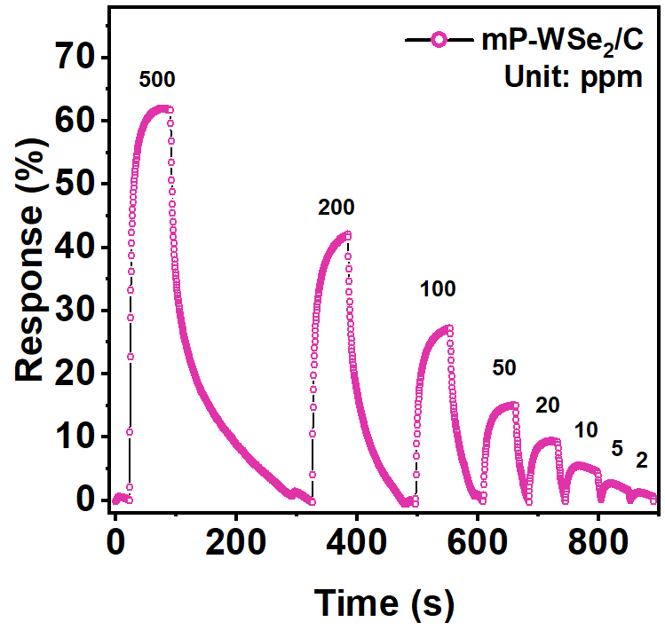
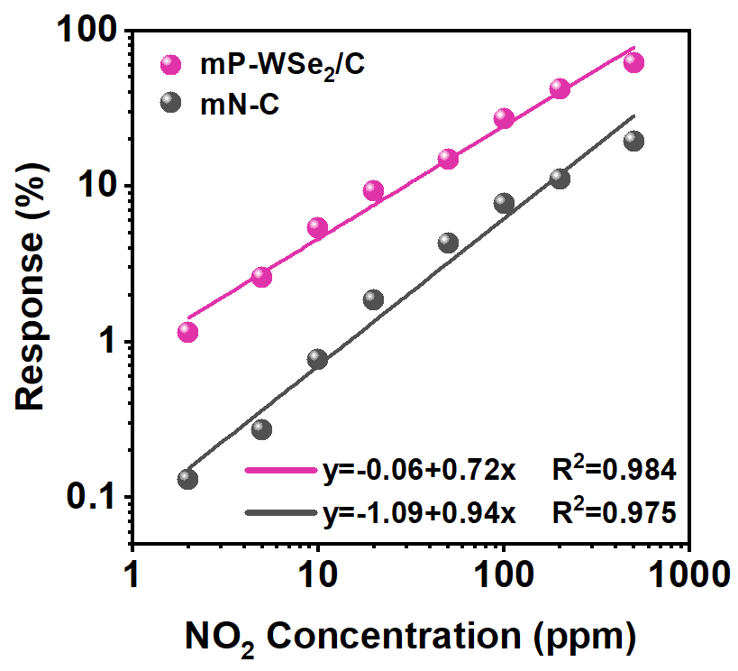
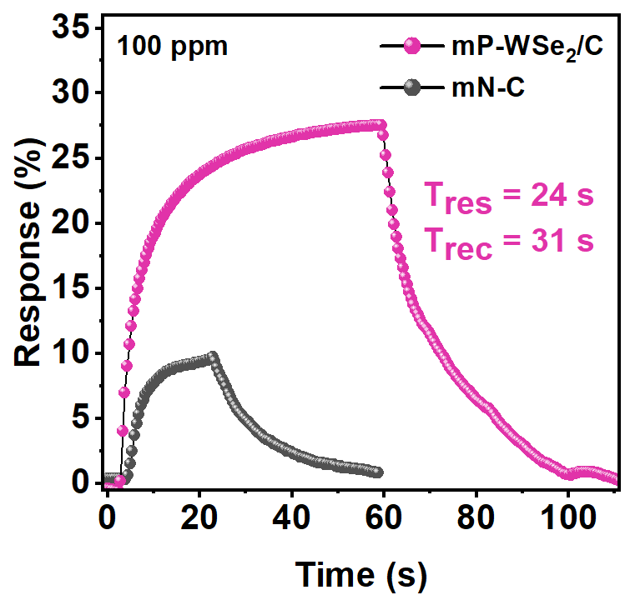
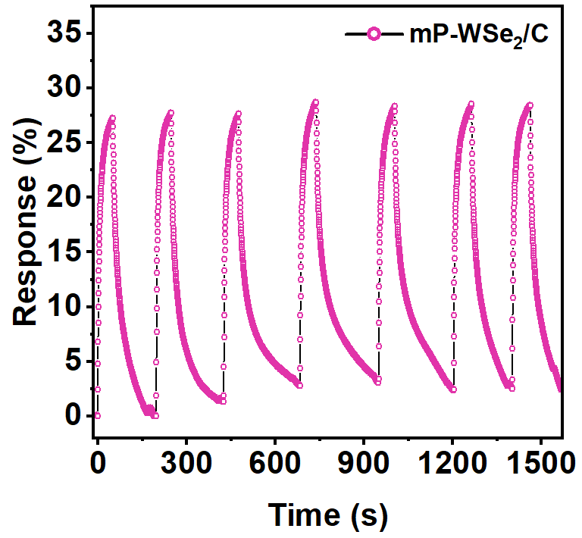















NO₂
e⁻
(a)
e-
e-
WSe₂
e-
e⁻
carbon
(b)
(c)
(d)
(e)
(f)
100 ppm
50 ppm
(g)
(h)

Slide 7






(a)
(b)
(c)
100 ppm
Wireless device
Sensor
ΔR/R₀=32 %
Testing box

Slide 8














(a)
E_{ads}= -0.39 eV
(b)
P-WSe₂
0.31 e
WSe₂
E_{ads}= -2.30 eV
0.77 e
(c)
(d)
(e)
1.90 Å
2.05 Å
1.53 Å
1.91 Å
1.53 Å
2.1 Å

